Slide 1
Imaging-related research in Canada
Presentation for WW-ADNI meeting
AAIC - Toronto, July 2016.
Dr. H. Chertkow: CCNA Scientific Director
www.ccna-ccnv.ca

Slide 2
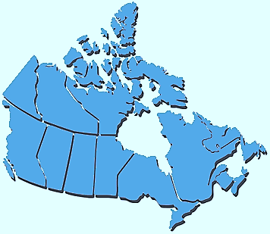
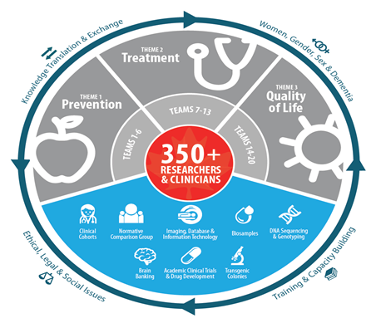
The CCNA
Canadian Consortium on Neurodegeneration in Aging Principal Investigator: Howard Chertkow
2014-2019
Five year Canadian government funded initiative
to accelerate discovery, innovation and adoption of new knowledge, directed at the prevention, treatment, and management of the neurodegenerative diseases of aging,
improve the quality of life of individual Canadians living with these disorders.
*Five Canadian sites are part of ADNI 2, will continue in ADNI 3

Slide 3
Recruitment Targets for COMPASS-ND
“Comprehensive Assessment of Neurodegenerative Diseases”
1600 individuals being recruited across Canada
Diagnosis | Minimum Number
Subjective Cognitive Impairment | 200
Mild AD | 200
Mixed AD/Vascular Dementia/VCI -Vascular Cognitive Impairment | 400
Mild Cognitive Impairment | 400
Lewy Body Disease/Parkinson's Dementia | 200
Frontal Temporal Dementia | 200

Slide 4
Choice of Inclusion and Exclusion Criteria
If narrowly-focused criteria, will produce homogeneous groups that represent a small fraction of the dementia population
May exclude co-morbidities and mixed dementias
ADNI example
AD
MCI
Mixed
SCI
LBD
VCI
FTD

Slide 5
Choice of Inclusion and Exclusion Criteria
Broadly inclusive criteria will produce heterogeneous groups that cover the entire dementia population
Include almost all co-morbidities and mixed dementias
Difficult to specify definitions of “pure” disease
AD
MCI
Mixed
LBD
SCI
VCI
FTD

Slide 6




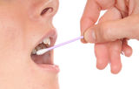
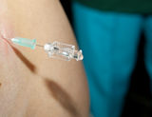




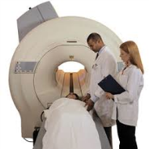
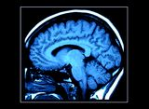



Protocol Flow in “COMPASS-ND”
1. Recruitment
Into CCNA
6.Biosamples
2. Informed Consent Signed
6b.Saliva
6.c
6a.Blood
6c.CSF
3. History, Physical, Cognitive
Evaluation
Demographics, medical/surgical history
Physical/Neurological examination
7. Sample Processing
8. Sample Shipping
to Biobank
9. MRI Imaging Acquisition
10. MRI IT and Databasing
4. Questionnaires
mental health
Social
psychiatric
C-Brain
LORIS
5. Psychometric
Testing
11. Brain Donation Program
and Follow-up in Clinic
National battery

Slide 7
Comprehensive Assessment of Neurodegeneration and Dementia
COMPASS-ND will provide deeply phenotyped cohorts
Genetic information: Genetic information: UK Dementia Biobank Affymatrix Chip = 240,000 SNP’s
3T MRI
Extensive behavioural data
Extensive clinical information
Neuropsychology
Biosamples: blood, saliva, csf, microbiome
longitudinal followup
Brain donation program, standardized neuropathology protocol

Slide 8
Comprehensive Assessment of Neurodegeneration and Dementia
COMPASS-ND will provide a normal comparison group
Planned 200 MRI studies within CLSA sub-cohort (Dr. E. Smith)
Planned normal (n=600) CCNA neuropsych normative group (Drs. R. Dixon and N. Phillips)

Slide 9
Our Approach
Novel approaches:
We will embrace the complexity of Neurodegenerative Diseases (NDD)
Assessing a range of NDD, liberal inclusion criteria, Mixed dementias, vascular + neurodegenerative elements
Look at risk factors, biomarkers, therapy response in real life “messy” and mixed dementia cases
Entertain the possibility of mixed/multiple therapy trials in years 3-5
Bring vascular assessment, VCI, vascular risk factors to centre stage
Studying shared mechanisms that cut across disease categories.
Leverage deeply phenotyped subjects:
Roll SCI, MCI, AD, FTD subjects into intervention studies at lower cost.
Treatment, not natural history cohorts.

Slide 10
Comprehensive Assessment of Neurodegeneration and Dementia
COMPASS-ND will launch therapeutic add-on interventions. Baseline assessment at entry serves as “pre-treatment” baseline.
We are not a “natural history” study
Currently:
Team 6 (Dr. Greenwood) – Diet in SCI
Team 10 (Drs. Belleville and Anderson) – Cognitive stimulation in SCI, MCI
Team 12 (Drs. Bherer and Montero-Odasso) – Exercise, cognitive stimulation in MCI
Future: tDCS in FTD and PPA

Slide 11




MRI Imaging
CDIP
Canadian Dementia Imaging Protocol
www.cdip-pcid.ca
3T MRI Sequences
1.5T MRI Sequences
Scout
3D T1
Sagittal
PD/T2
Axial
FLAIR
Axial
T2*
Axial
DTI
30 dirs
BOLD
Resting
7 mins
5 mins
7 mins
5 mins
6 mins
11 mins

Slide 12
Image Processing
Each MRI scan will be uploaded onto LORIS
Contracted with “True Positive” – Canadian company (Drs. Collins and Duchesne)
To carry out brain and hippocampal volumetrics within week
Volumetric data to be fed back to clinicians to monitor impact on clinical care
Getting volumetrics “out of the ivory tower and into the clinic”

Slide 13
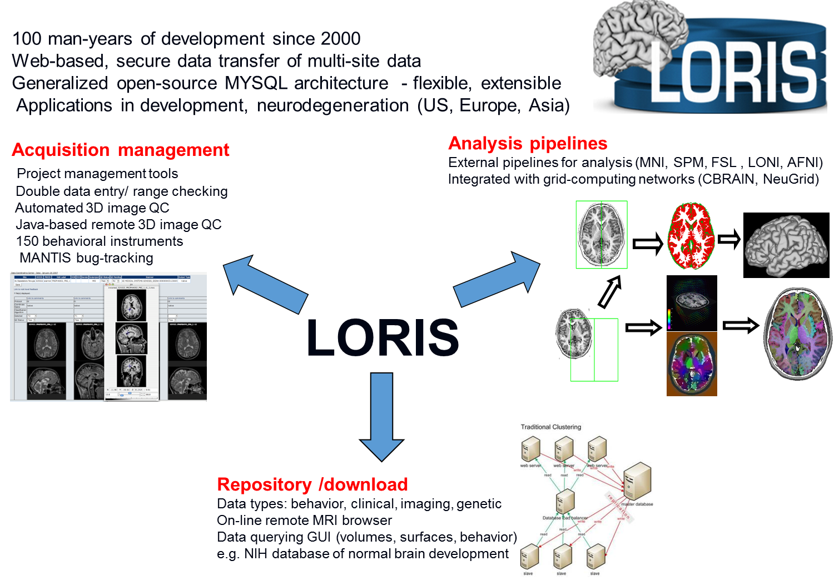
LORIS Database

Slide 14
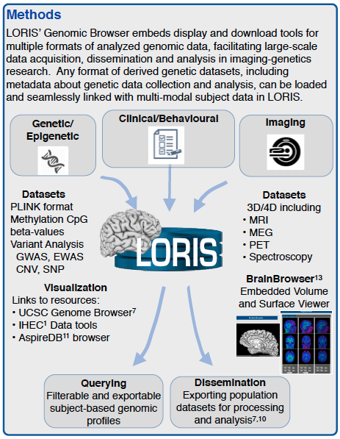

LORIS Data Types
Data Types
Imaging
Behaviour
Genetics
Epigenetics
Tissue samples

Slide 15
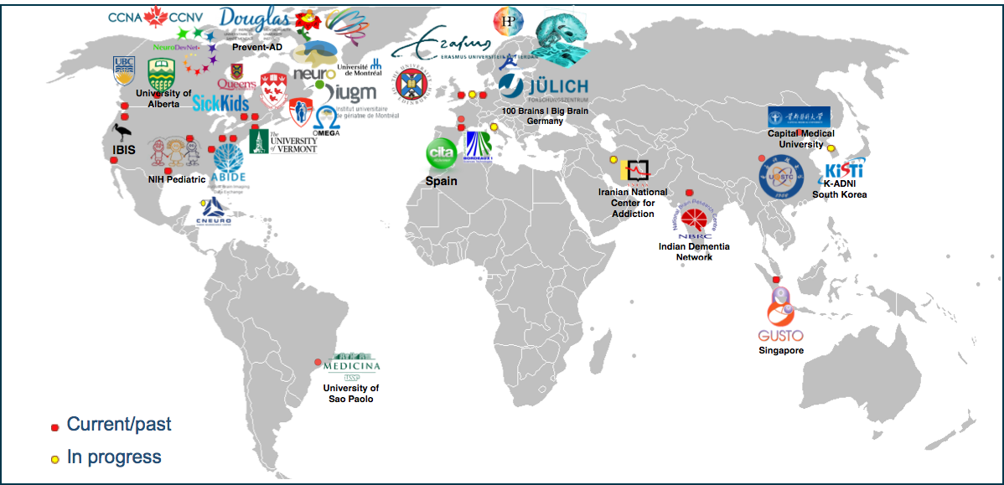
International Partners
For list of 400+ measures: https://sites.google.com/site/lorisinstrumentlist/

Slide 16
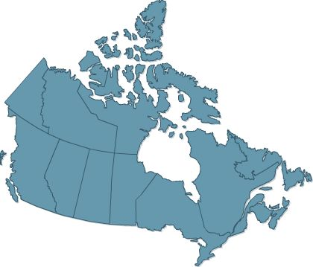













CBRAIN Canadian Distributed Neuroimaging Platform
Data
Computing
Distributed Architecture
Users

Slide 17

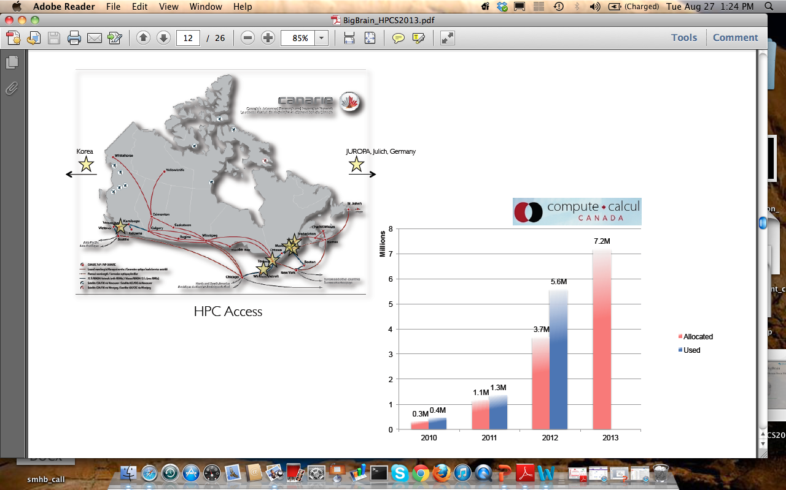
CBRAIN National Integration
CBRAIN National HPC Integration (200,000 processors)

Slide 18
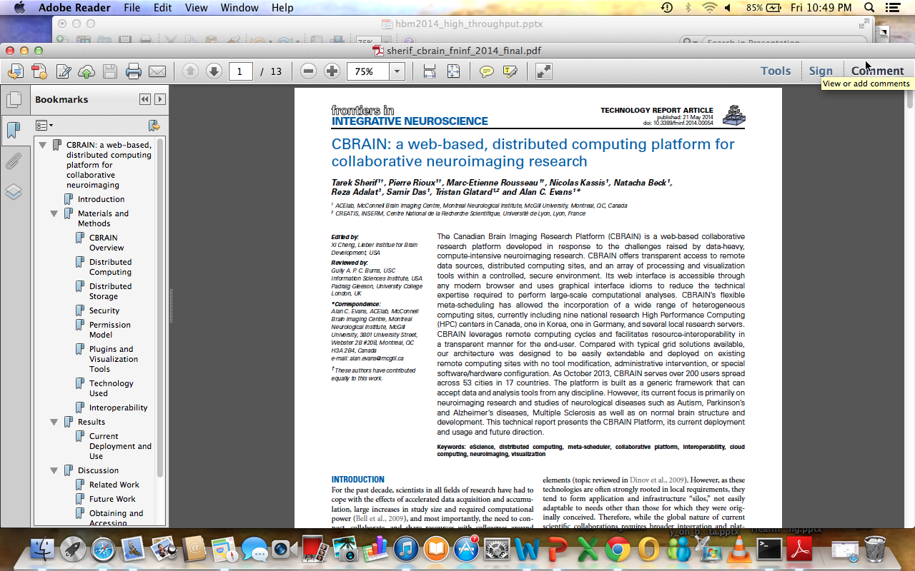
CBRAIN

Slide 19
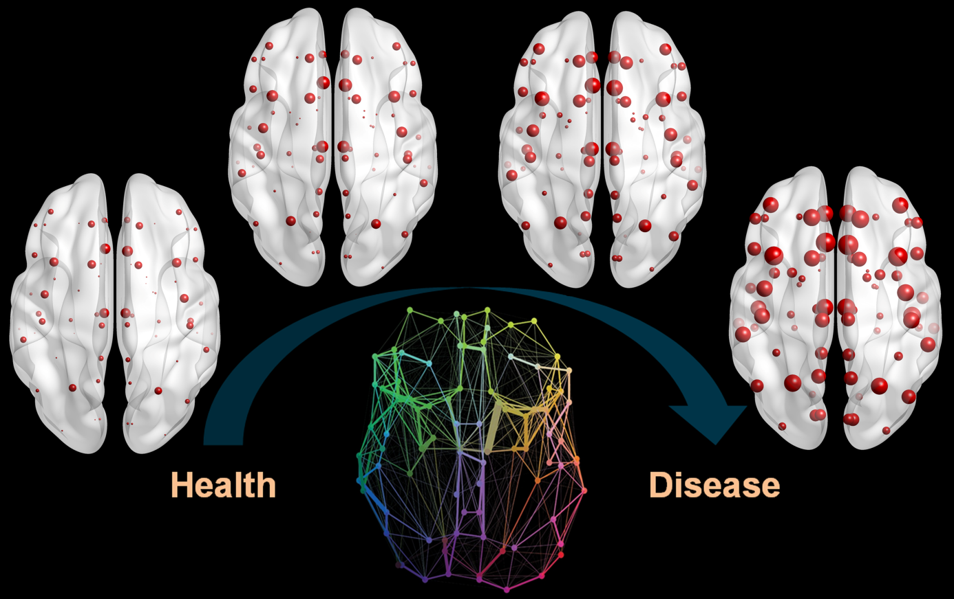
Novel evaluation of virtually ALL ADNI data!
“Early role of Vascular dysregulation..”
Multi-Factorial Data-Driven Analysis (MFDDA)
(Iturria-Medina et al, Nature Communications, 2016)

Slide 20
Multi-Factorial Data-Driven Analysis (MFDDA)
Characterised LOAD progression and relation to spatiotemporal alterations in:
Brain amyloid (A_{β)}
Metabolism
Vascular regulation
Functional activity
Structural properties
Cognition
peripheral proteins level
7700 multi-modal brain images from 1171 healthy and diseased ADNI subjects
Plasma (146) and CSF (87) factors for all subjects and MMSE score
AAL atlas: 78 grey matter ROIs
Calculate “abnormality trajectory” for each ROI and factor combination
LOAD abnormality index for all factors (normalized area under trajectory)
Temporal ordering of disease progression

Slide 21
Modalities and Associated Biomarkers from ADNI
AV-45 PET→ Amyloid A_{β} deposition (n = 901, n_{long}=1079)
Arterial Spin Labeling (ASL) → Cerebral Blood Flow (n = 343 , n_{long}=1145)
fMRI → connectivity, Regional Homogeneity, faLFF (n = 164 , n_{long}=621)
FDG PET → Glucose Metabolism SUVR (n = 1070, n_{long}=1680)
T1 MRI → GM Density and Atrophy (n = 1092 , n_{long}=4943)
Plasma and CSF measures → over 200 proteins concentrations (n = 326, n_{long}=1063)
Covariables → MMSE score, age, sex, apoe E4, clinical state, educational level (all)

Slide 22
Hypothetical vs. Data-driven Models of LOAD Progression
Jack et al. Iturria-Medina et al.
Main differences:
Absence of a vascular component, assumption that A_{ß} is earliest biomarker.
Vascular dysfunction is earliest pathological event, followed by Aß deposition.
CSF A_{ß} and tau are the two major proteinopathies,
Not among the earliest/strongest altered proteins (abnormality positions 85, 41).
Cognitive decline only detectable at advanced stage.
Cognitive changes observable in parallel with alterations in primary factors.

Slide 23
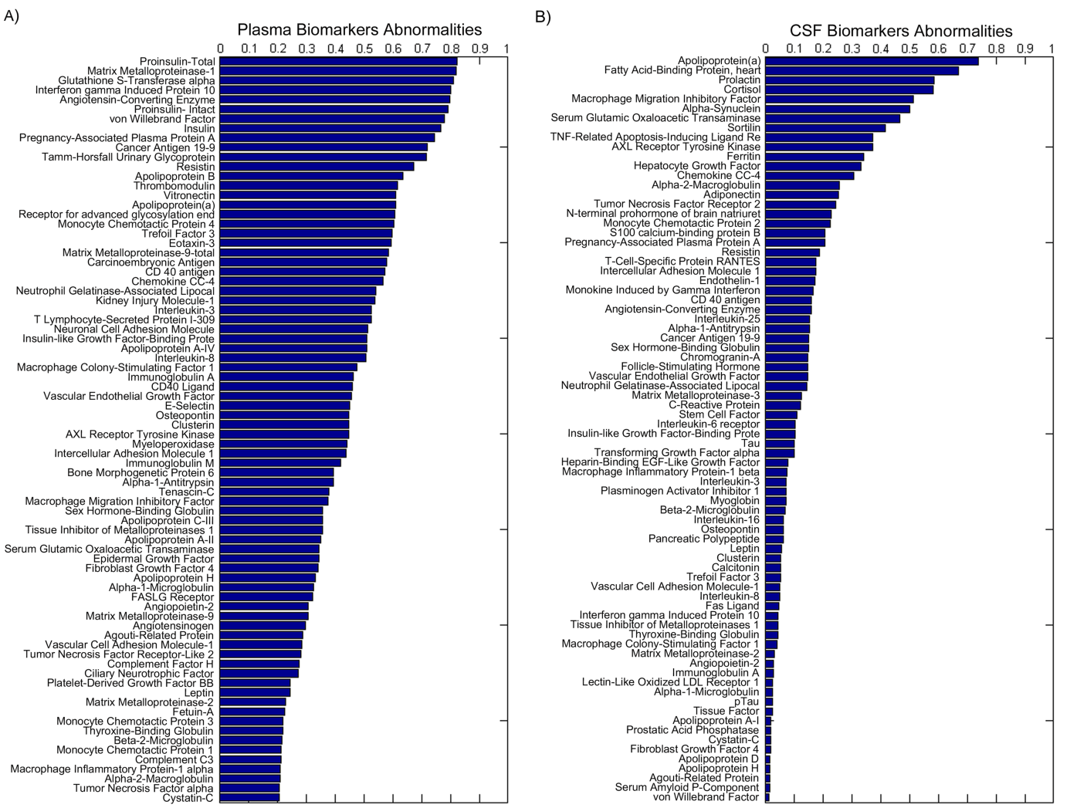
Plasma and CSF Biomarker Levels in LOAD
tau
p-tau
A_{ß}

Slide 24
Plasma, CSF Biomarkers Levels in LOAD
Plasma
Pro-insulin → Brain insulin resistance linked with BBB breakdown. “Type III diabetes”
Plasma Matrix Metalloproteinase 1 → linked to neuroinflammation, BBB deregulation
Glutathione S-Transferase Alpha → oxidative stress ; pathway for BBB deregulation
Angiotensin-Converting Enzyme → controls blood pressure and vessel constriction
CSF
Apoliprotein A → central role in lipid metabolism and vascular integrity, CV disease
Heart Fatty Acid Binding → fatty acid metabolism, biomarker of specific CV disease
Cortisol → risk factor for stress and neurodegeneration

Slide 25
International Linkages and Opportunities
CCNA as partner with GAP NET and EPAD
Trial ready cohort and registries
Big Data – link with UK Dementia Platform (UKDP)
Big Data in Dementia Canadian initiative
Memorandum of Understanding with UKDP
Big Data – Use of LORIS and C-Brain in Canada for big data imaging of CCNA and international cohort data.

